Slide 1
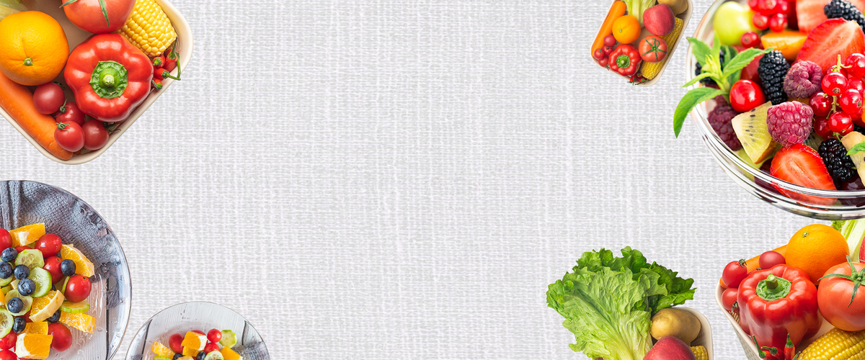
Who is this menu for？
QUIZ！

Slide 2
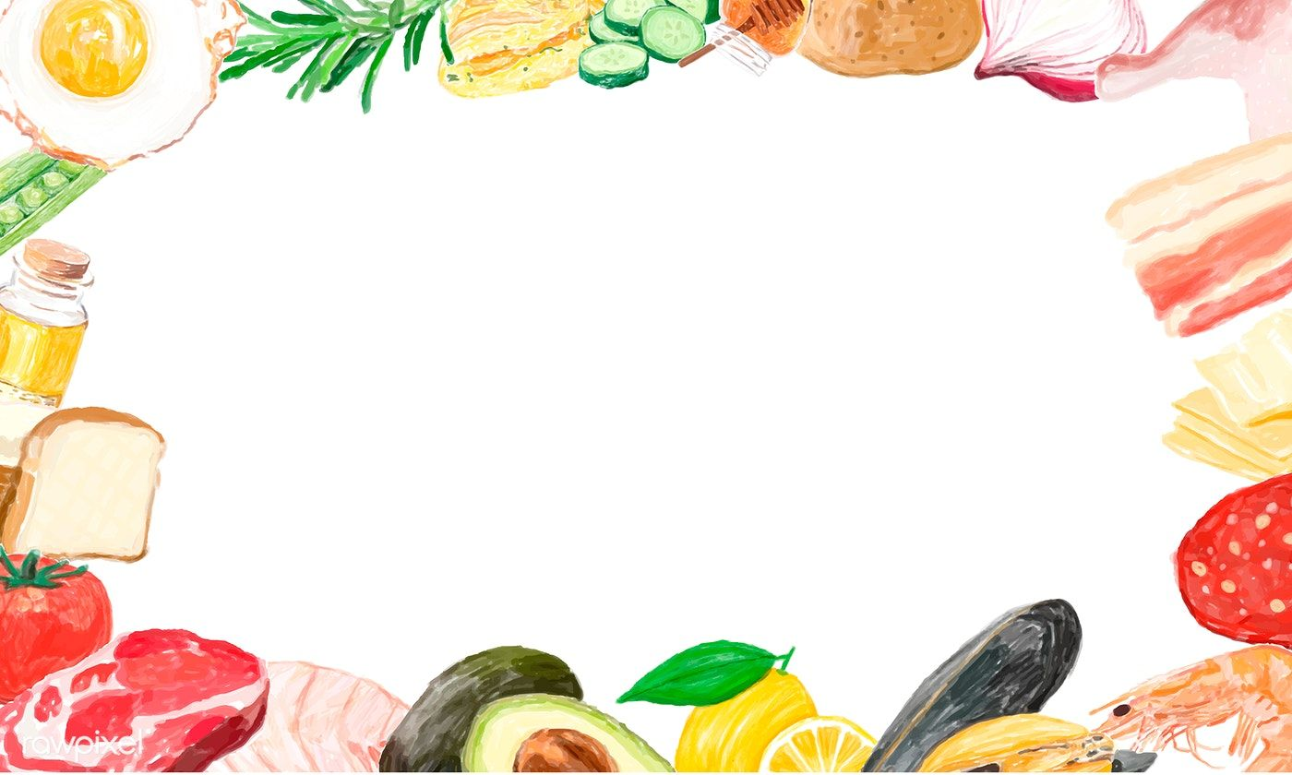
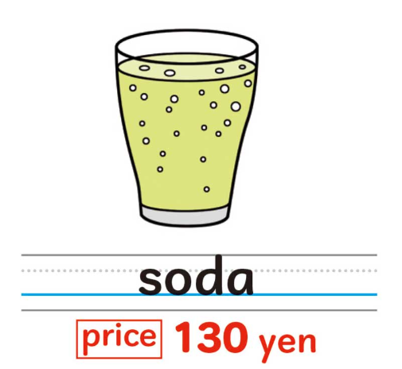

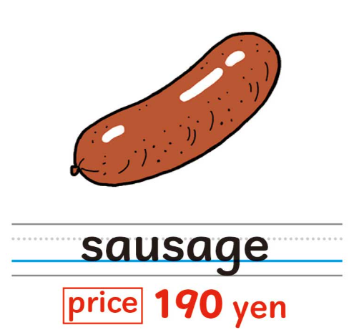
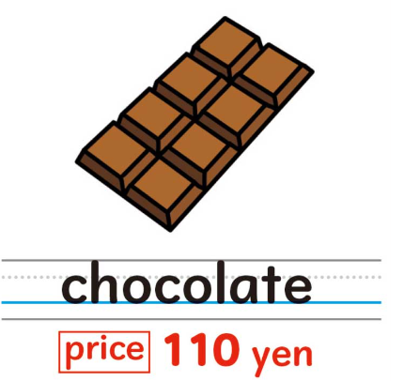
Drink
Hint 1
920 yen
Main dish
Side dish
Dessert

Slide 3
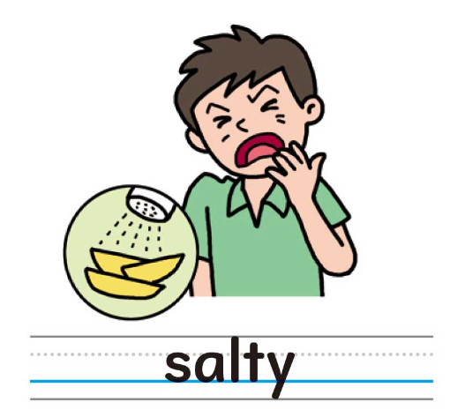
Hint 2
It’s
.

Slide 4
Hint 3
He can play basketball.
He likes chocolate.

Slide 5
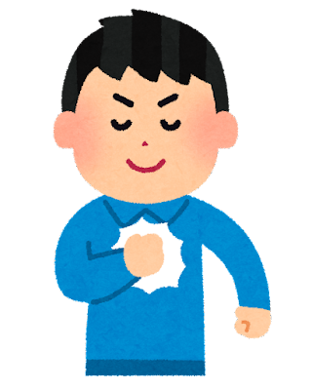
Answer
〇〇
sensei

Slide 6
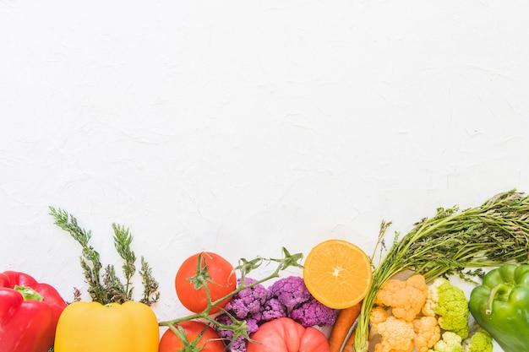
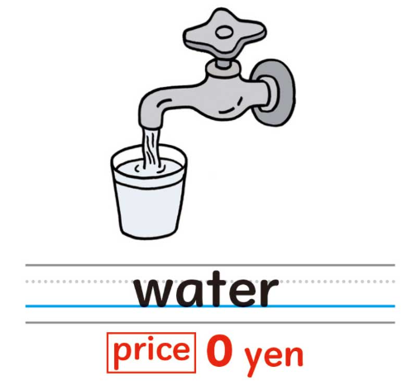
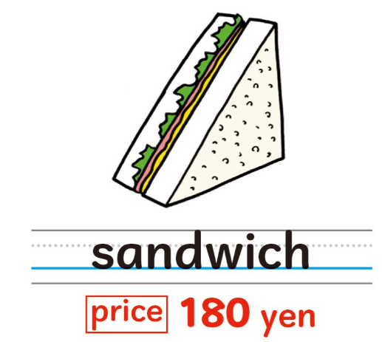
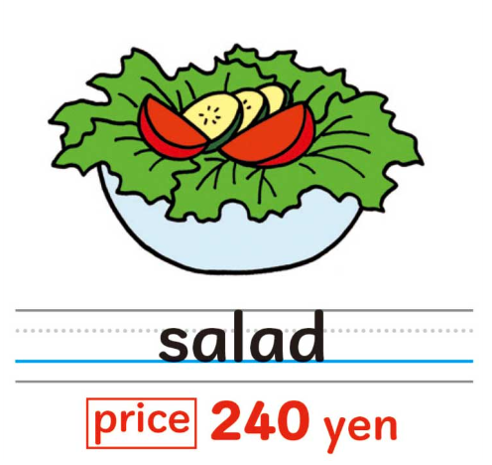
Drink
Hint 1
420 yen
Main dish
Side dish
Dessert

Slide 7

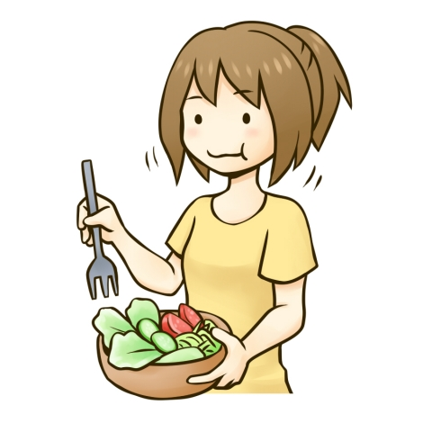
Hint 2
It’s
healthy
.

Slide 8
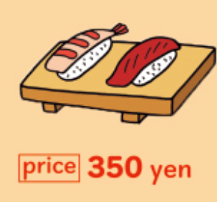
Hint 3
She can play badminton.
She likes sushi.

Slide 9
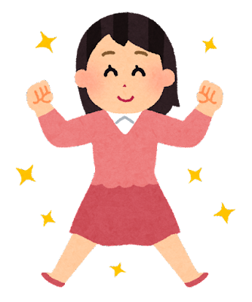
Answer
△△
sensei

Slide 10

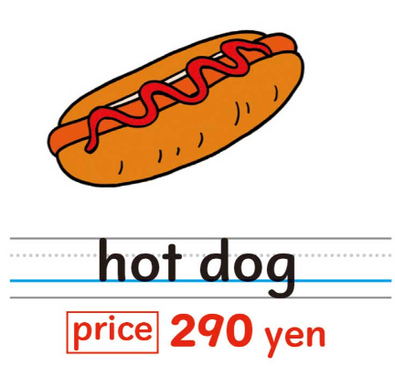
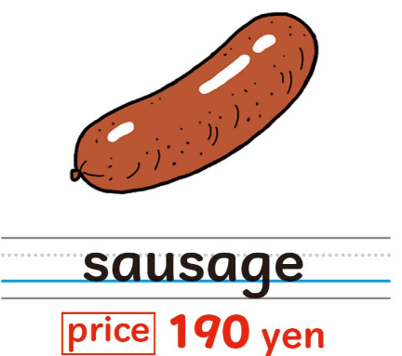
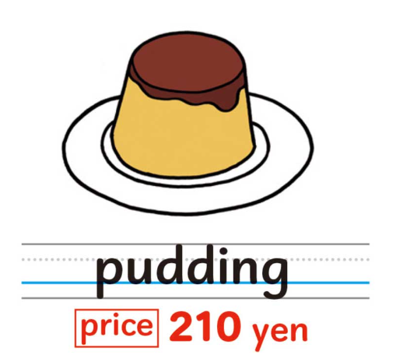
Drink
Hint 1
790 yen
Main dish
Side dish
Dessert

Slide 11
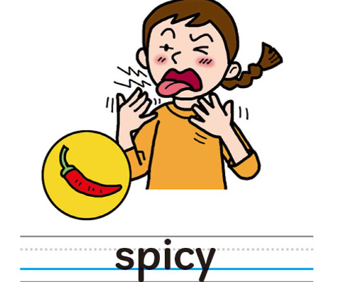
Hint 2
It’s
.

Slide 12
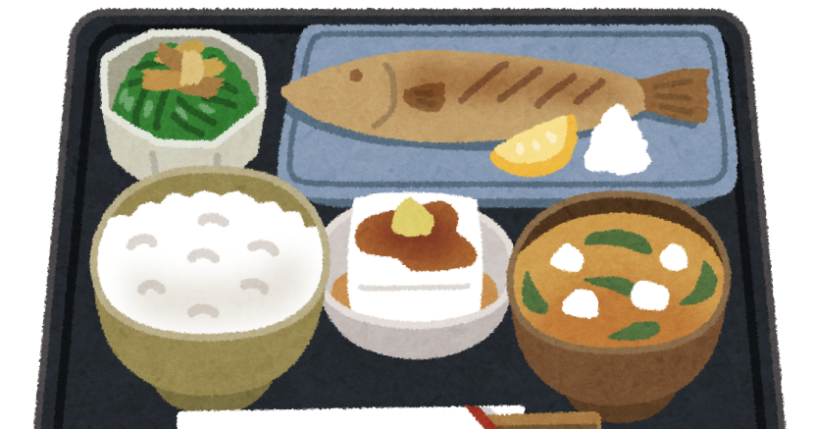
Hint 3
She can swim well.
She likes spicy food.

Slide 13
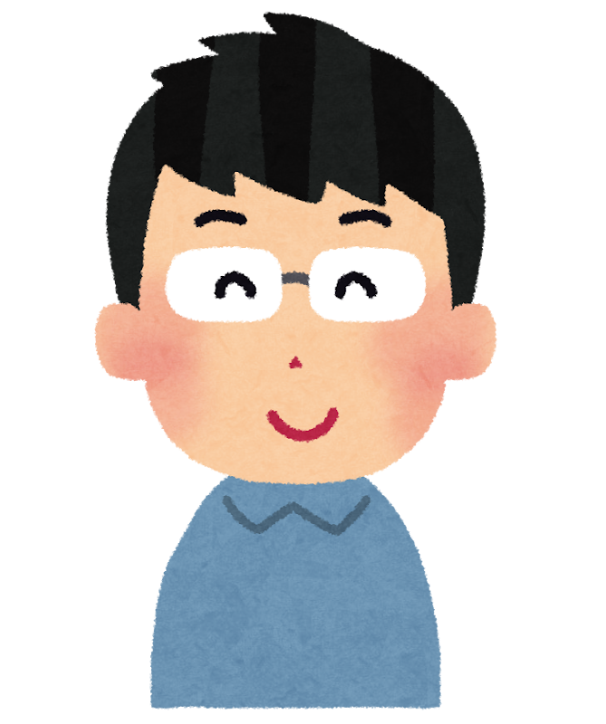
Answer
◇◇
sensei

Slide 14
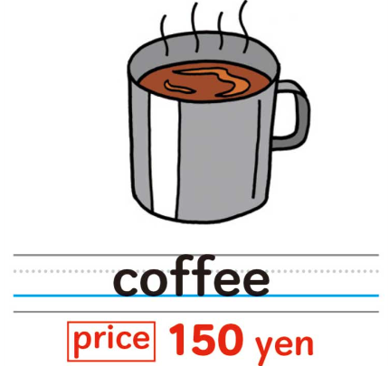

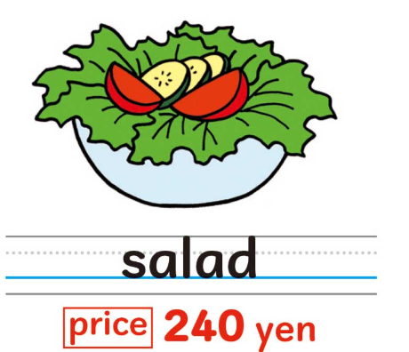
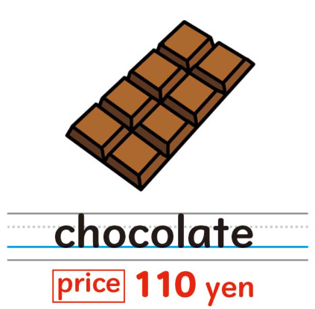
Drink
For □□ sensei
990 yen
Main dish
Side dish
Dessert

